Slide 2
Intro to Node Part I: How does it work?
Instructors: Alejandra Q. & John C.
GitHub handle: @alequetzalli & @johncokos
Website: http://shecodesnow.com

Slide 3
In Part 1, we will cover...
History of how we came to use Node.js.
What are the top benefits of Node?
You can make your own server.
You can become a full-stack/back-end developer with your knowledge of JavaScript. (JavaScript developers no longer are forced to learn a new language such as Java to do back end programming!)
You don't need to use bash scripts (which won’t work in a windows machine), and simply write those scripts in JS.
How do servers work anyway?
Build a simple "HELLO WORLD" app and HTTP server.

Slide 4
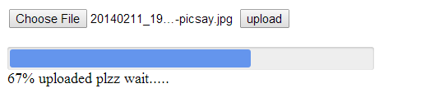
Did You Know?
Ryan Dahl was inspired to create Node after seeing a file upload progress bar on Flickr which didn’t know how many files had been uploaded.
The browser did not know how much of the file had been uploaded and had to query the Web server. This took too much time and he decided to do something about it!

Slide 5

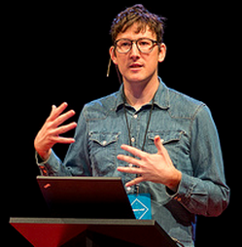
History of how Node came to be…
In 2009, a nearly broke Ryan Dahl introduced Node.js to world at the European JS Conference.
Notes:
- Practically begged for a slot at the European JS conference
- Fast forward a few years later in 2012…looking better! Fancy hairdy and everything...

Slide 6
History of how Node came to be…
Before JS wouldn't run the same way in diff browsers *
This age was called the “Browser Wars” !
Notes:
* Before JS wouldn't run the same way in diff browsers.
now if you click this thing, this over here will change...it became dynamic
This age was called browser wars…and they all ran JS diff (John interjects here ...)

Slide 7
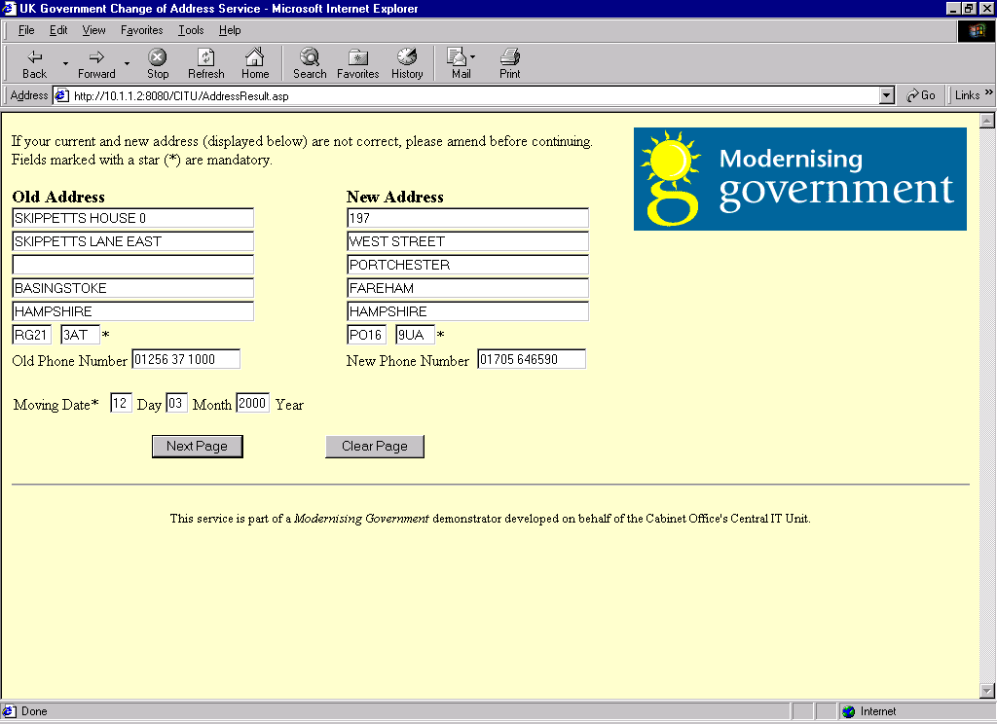
History of how Node came to be…
Before JS only ran in browsers and it could only do simple things like forms submissions.

Slide 8
History of how Node came to be…
Some said JavaScript was a toy!

Slide 9
History of how Node came to be…
JS couldn't talk to servers at all
JS could use AJAX to talk to PHP applications on an Apache server.
A Developer wanted to be full-stack, he/she would have been forced to choose a track. (EX: PERL, PHP or Java)
When new languages would replace others due to industry changes, the Dev now had to learn a new language all over again.

Slide 10
History of how Node came to be:
Web browser engine; this renders the HTML/CSS on your browser
So when Ryan Dahl realized that all major browsers used WebKit, which used V8…he realized this opened the door for creating Node!
Developers who wanted to be full-stack no longer needed to learn a whole other language. Now all they had to do was learn how to use the Node environment and pair it with JavaScript!
The JavaScript engine that is used in Google Chrome; this executes the JS in your browser

Slide 11
What are the top benefits of Node ?
Previous Front-End JS person who could before only work in the browser, can now do all kinds of things. (EX: command line application)
It can be used to make your own web server; node servers are self contained.
It’s asynchronous; you are just waiting for the slowest JS function to finish v.s. running One. At. A. Time.

Slide 12
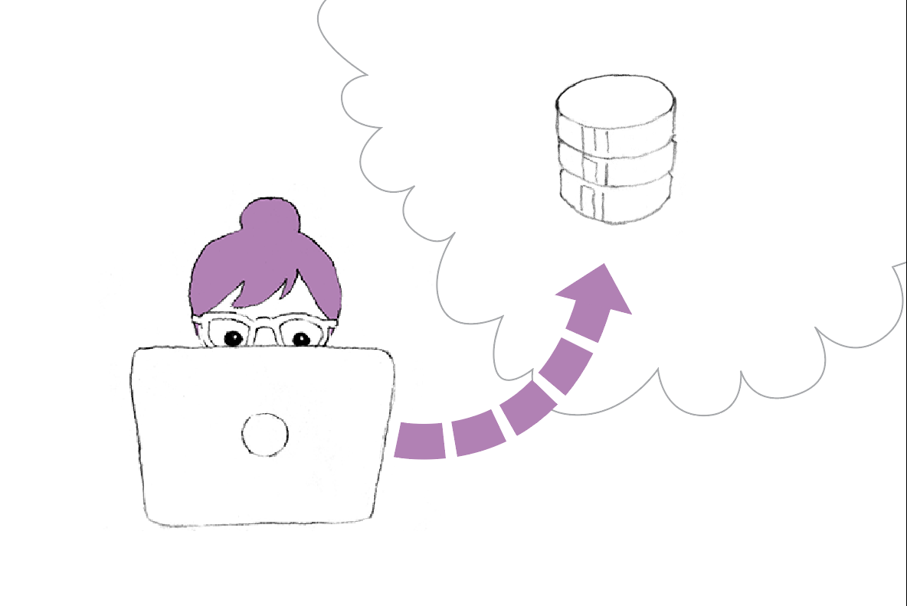
How do servers work anyway?

Slide 13
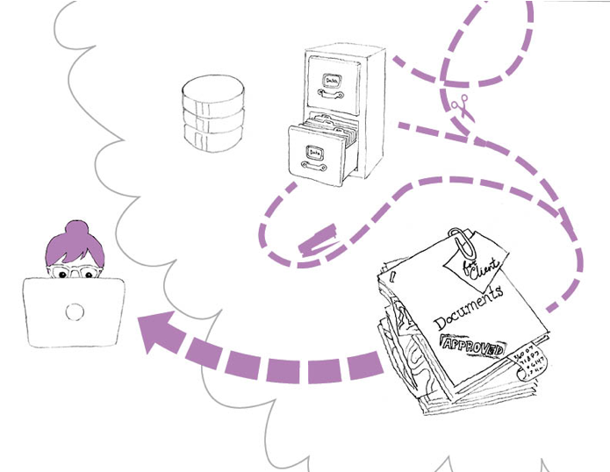
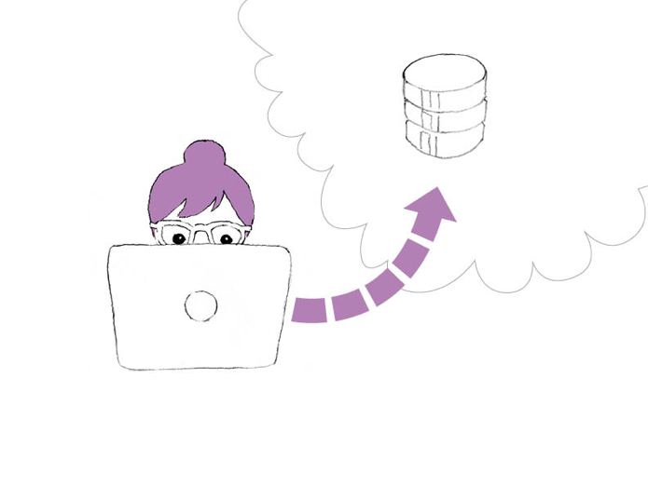
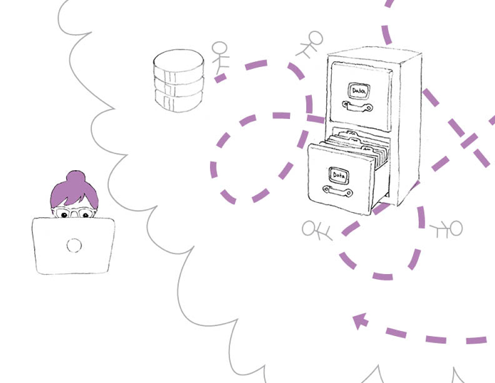
Back in my day …
http://www.domain.com/page
The web server tries to “handle” your request …
Do I have a file?
Is there a folder?
Is there a PHP, Perl, Ruby App?
Is there some Java to run? Do I need to go somewhere?
Once it figures all of that out
The work to generate HTML is then delegated
HTML is returned to you
Notes:
The URL is like you making a CALL.
The domain part is the phone number.
The stuff after the ”/” is the path or the actual request (like who do you want to talk to?)
Sometimes there’s a port (:8080) and that’s like the extension
The Server is like the operator. Remember seeing the old switchboard operators?
It answers the call
And figures out how to route it to the righe person to handle the request
Waits
Makes connections
Moves the wires around
Over and Over

Slide 14
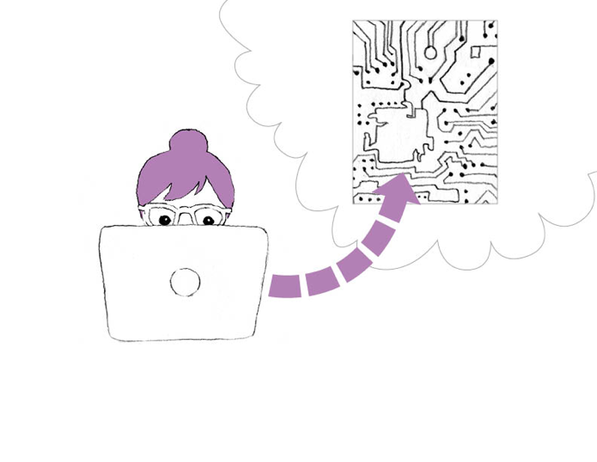
In Node.js
All of that madness is now code.
The route (/phae) is now a function instead of Filesystem hops
That function might spawn some service calls to fetch data
The renderer maps data (if any) to a template
HTML is given to the user
Notes:
Instead of delegating and playing traffic cop for all of that craziness … a Node server is totally self contained.
It listens
It reacts
It does the work
It makes the output
And it sends it to you
And it all is optimized and written in a common language!

Slide 15
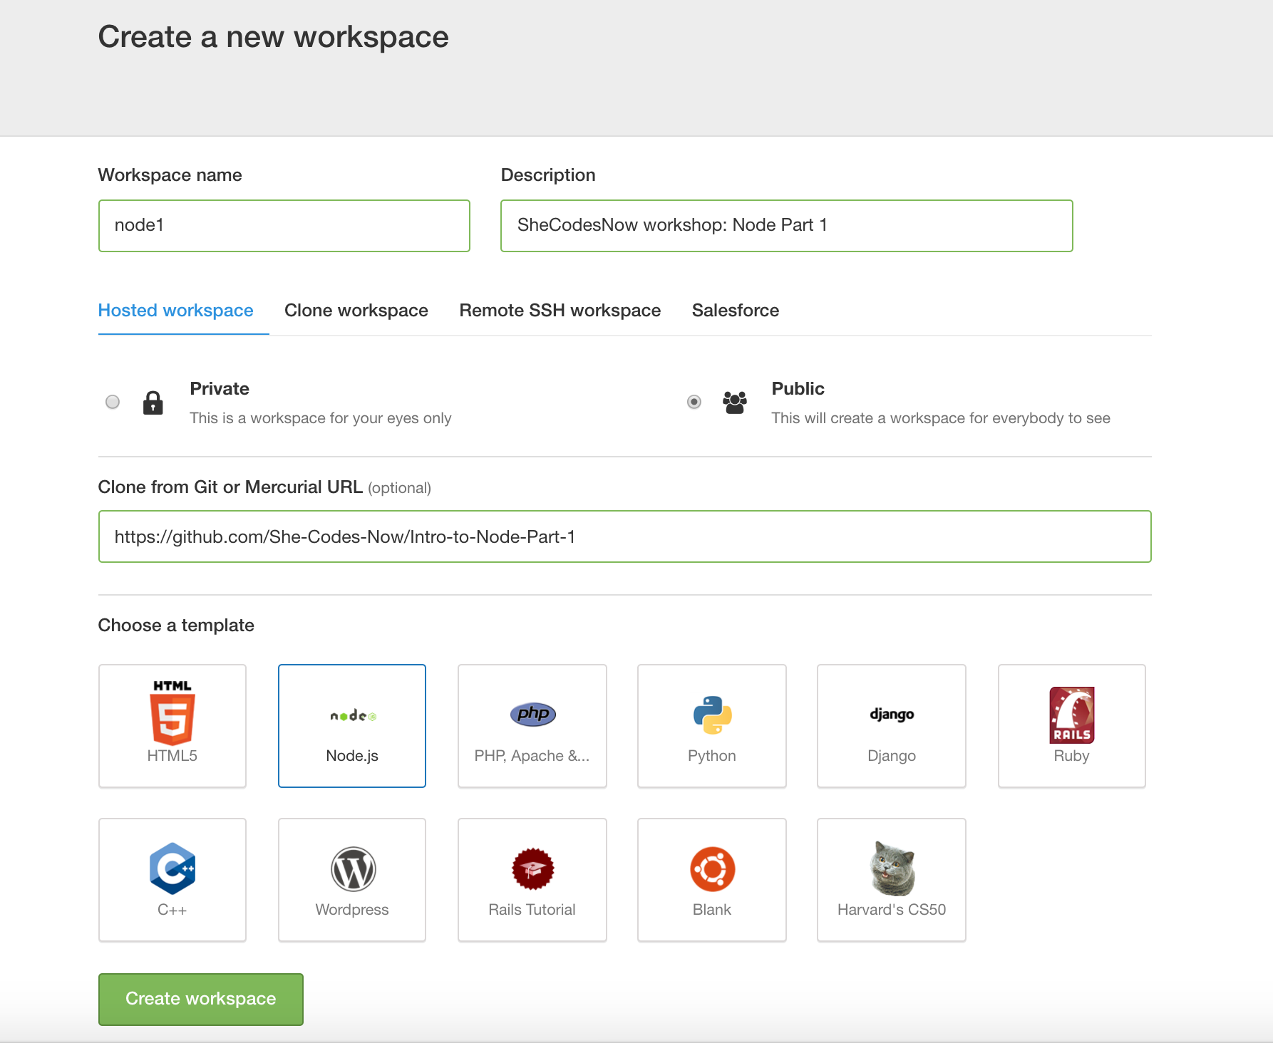
Go to Cloud9; online tool
Cloud 9: https://ide.c9.io
GitHub repo for this class: https://github.com/She-Codes-Now/Intro-to-Node-Part-1

Slide 16
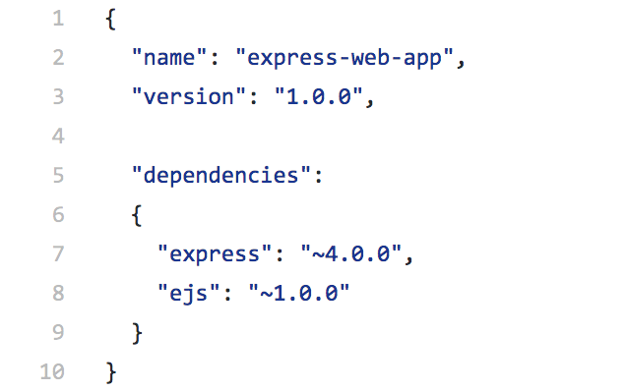
In your package.json file…
Express is a web application framework for Node.js.
EJS is a templating language that generates HTML markup with JavaScript.
"E" is for "effective."

Slide 17
Extra Learning Sources:
http://www.node-console.com/script/code
http://www.tutorialspoint.com/codingground.htm

